Slide 1
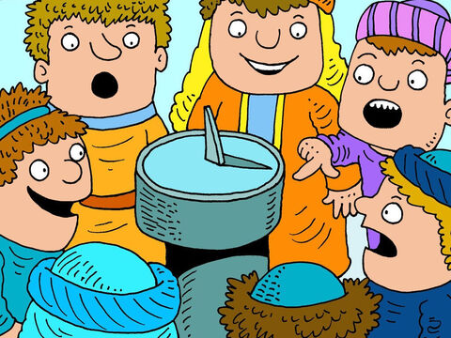
HEZEKIAH AND THE SUNDIAL 2 Kings 20:1-11, Isaiah 38:1-22

Slide 2
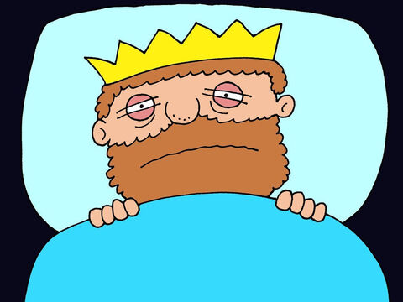
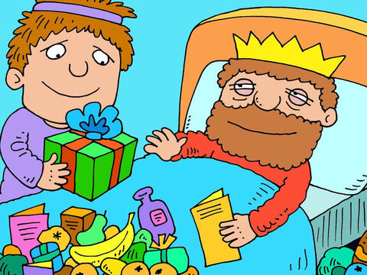
One day, King Hezekiah was feeling very ill. He lay in bed wondering whether he would ever get well again. He had a very nasty boil full of infection. People came to wish him well and show their sympathy.

Slide 3
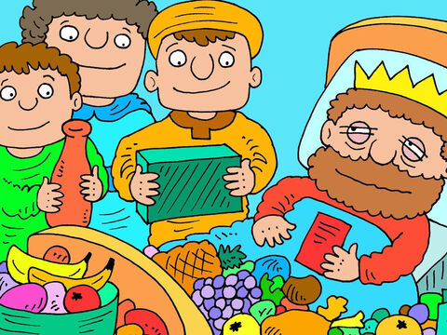
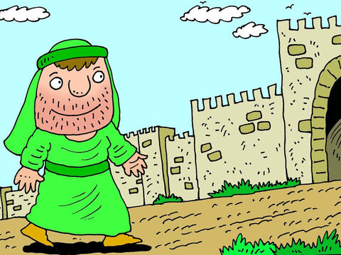
‘Get well soon,’ they said. ‘Sorry to hear about your illness’. Then, Isaiah, a prophet of God came to visit King Hezekiah.

Slide 4
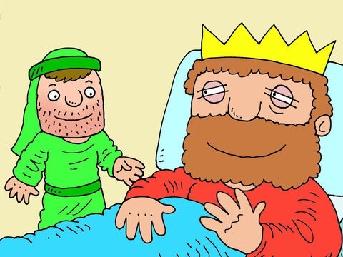
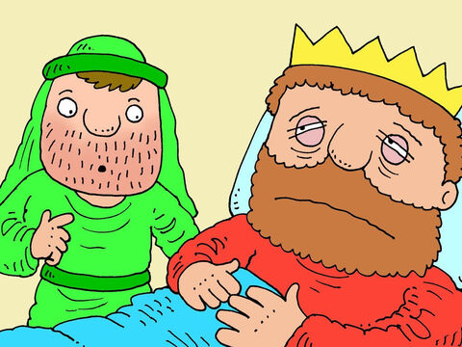
When Isaiah walked in the King brightened up. ‘Perhaps the prophet has some good news for me?’ he thought. But Isaiah had some very bad news for the King. ‘It’s time to get things in order,’ he said. ‘You are going to die.’

Slide 5
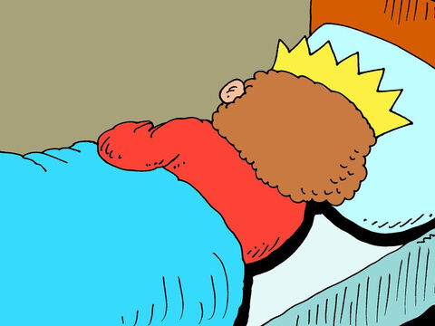
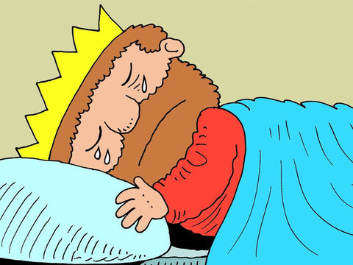
The King was devastated by this news. He turned his face to the wall and started to pray, very sadly, to the Lord he loved and trusted. ‘I’ve tried to be a good king,’ he wept. ‘I’ve tried to obey you. Please don’t let me die.

Slide 6
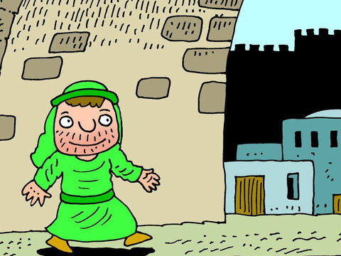
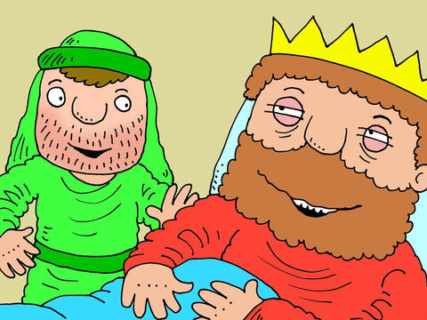
As the King lay crying on his bed, Isaiah was walking out of the palace when suddenly the Lord called out to him. ‘Go back to the King. I have heard the King’s prayers and have seen his tears. In three days time I will make him better.’ Isaiah went back to the king and told him what God had said. He was delighted. ‘You have another 15 years to live,’ said Isaiah.’

Slide 7
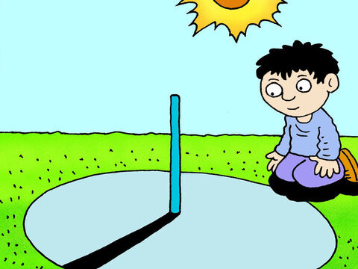
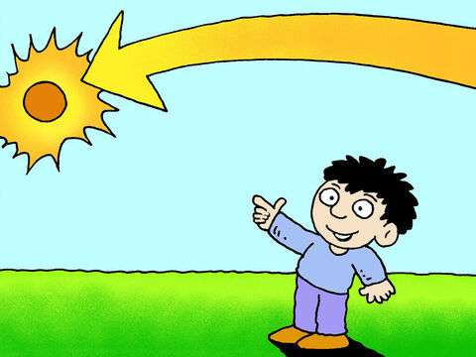
Now in those days people told the time by using a sundial. As the sun moved across the sky from east to west it cast a shadow. And as the sun only moved across the sky in one direction the shadow would only go in the same direction day after day. But something strange was about to happen.

Slide 8
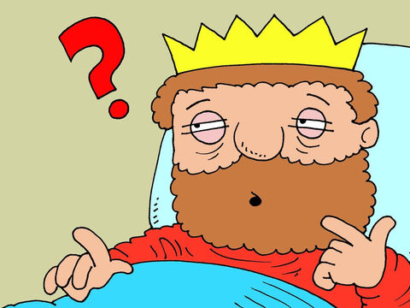
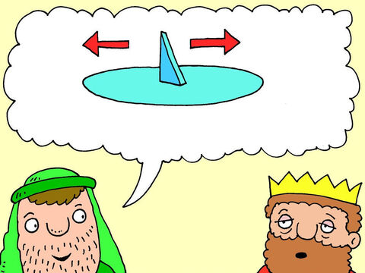
After a short time, Hezekiah started to worry. ‘Can the Lord give me a sign to show me He really will do what he says?’ ‘Yes,’ said Isaiah. ‘God will make the shadow on your sundial move ten degrees Which direction would you like the shadow to move – forwards or backwards?’

Slide 9
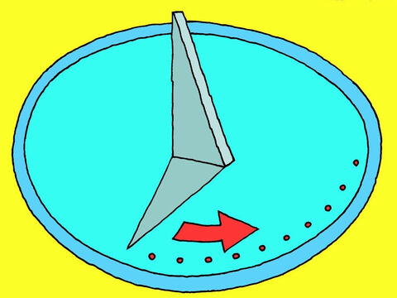
‘Well,’ the King pondered, ‘It is easier for the shadow to go forwards as that is the direction it moves anyway. So I want it to go backwards.

Slide 10
The king sent servants to watch the sundial. To their amazement they saw the shadow move backwards around the edge by 10 degrees. It was like a time was going backwards. We don’t know how God did this but He is the creator of everything and can do the impossible.

Slide 11
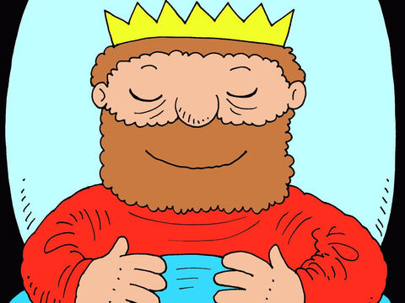
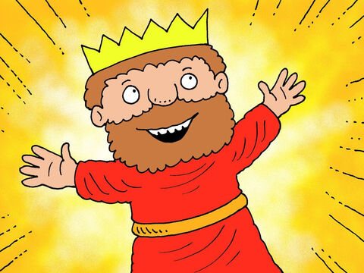
When the king heard what had happened he lay back with a sigh of relief. If God could make time go backwards then he was sure God would heal him add 15 years to his life. Isaiah ordered his doctors to put old fashioned medicine on his big boil to help it heal. And sure enough, three days later, Hezekiah was out of bed and feeling great.

Slide 12
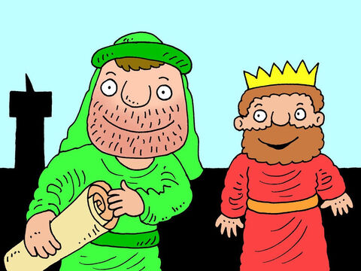
King Hezekiah’s story helps us to appreciate that every day we live is a gift from God. Hezekiah went into the temple to sing songs of thanks and praise to God. The words of thanks the King gave to God for healing him can be found in chapter 38 of Isaiah’s book.

