Slide 1
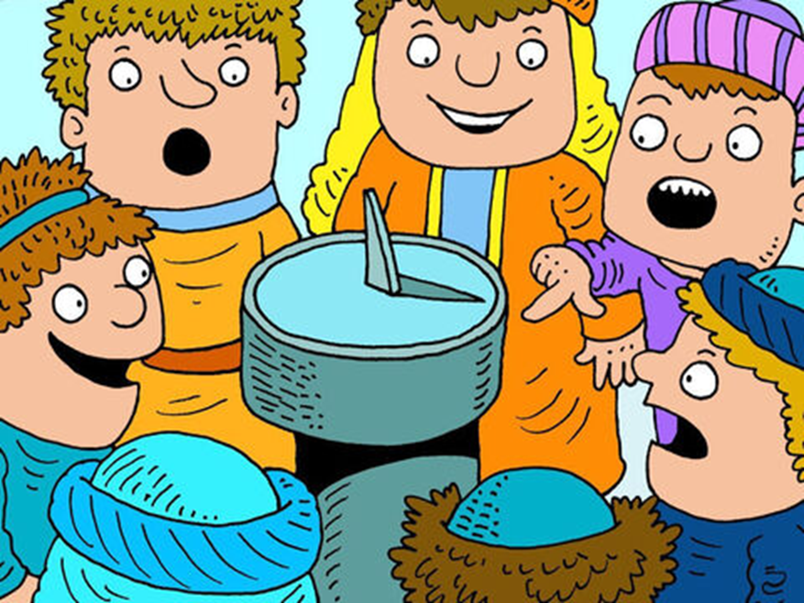
HEZEKIAH AND THE SUNDIAL 2 Kings 20:1-11, Isaiah 38:1-22

Slide 3
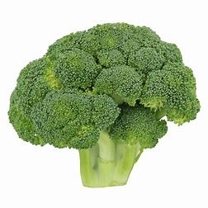
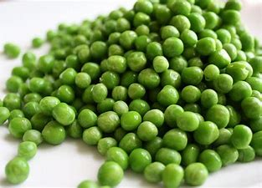
Eat peas or brocolli

Slide 4
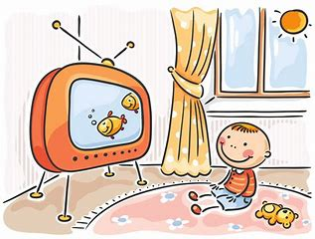
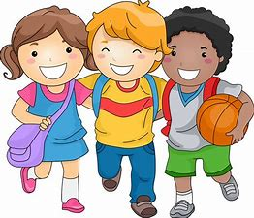
Watch TV on your own or play with friends

Slide 5
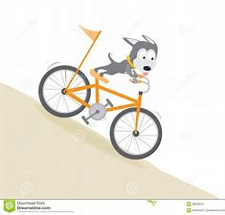
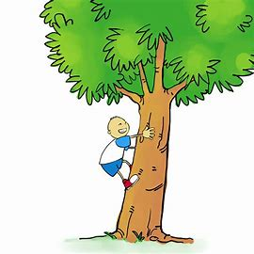
Cycle down hill or climb a tree

Slide 6
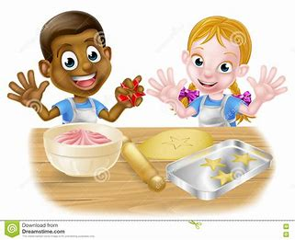
Build a cake or bake a cake

Slide 7
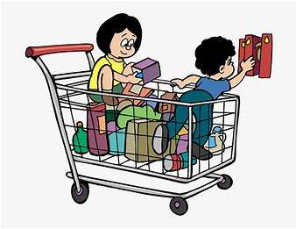
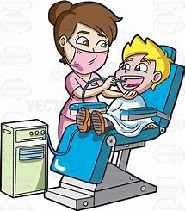
Go shopping or go to the dentist

Slide 8
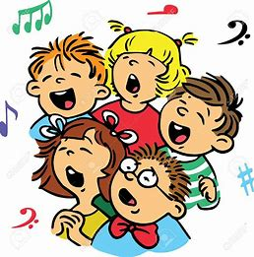
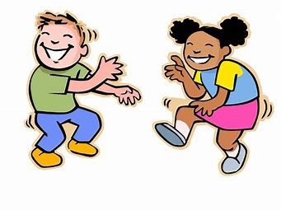
Sing a song or dance a dance

Slide 13
HEZEKIAH AND THE SUNDIAL 2 Kings 20:1-11, Isaiah 38:1-22

Slide 14
Psalm 18: 1-6
How I love you, Lord! You are my defender. ² The Lord is my protector; he is my strong fortress. My God is my protection, and with him I am safe. He protects me like a shield; he defends me and keeps me safe. ³ I call to the Lord, and he saves me from my enemies. Praise the Lord! ⁴ The danger of death was all around me; the waves of destruction rolled over me. ⁵ The danger of death was around me, and the grave set its trap for me. ⁶ In my trouble I called to the Lord; I called to my God for help. In his temple he heard my voice; he listened to my cry for help.

Slide 16
